Slide 1


Community Curiosity Challenge Consideration Commitment
WQE Events
Spring term 2026
WELCOME TO ALL ABOUT APPRENTICESHIPS
The session will start
at 5.30 pm

Slide 2
Community Curiosity Challenge Consideration Commitment
WQE Events
Spring term 2026
ALL ABOUT APPRENTICESHIPS
Kate O’Farrell
Careers Education Manager

Slide 3


Community Curiosity Challenge Consideration Commitment
WHAT WE WILL COVER
An overview of Apprenticeships to include
- What an Apprenticeship is
- How to find Apprenticeship opportunities
- The application process including timelines
- Hints and tips on how to strengthen an application
- What students can (and should) be doing from now
- Useful websites and resources
The opportunity to ask any questions you have using the chat function
Notes:
Running through the presentation we’ll touch on some of the (sometimes harsh) realities around Apprenticeship applications and giving you some examples of WQE students

Slide 4
WHAT IS AN APPRENTICESHIP?
Community Curiosity Challenge Consideration Commitment
An Apprenticeship is a full-time job where you also work towards a qualification linked to that job – earn & learn!
As well as paying you a salary, the company you work for will also pay for your qualification (even if it’s a degree or University level qualification)

Slide 5
APPRENTICESHIP LEVELS
Community Curiosity Challenge Consideration Commitment
Advanced: Level 3
02
Higher: Level 4/5
03
Degree: Level 6+
04
Intermediate: Level 2
01
Notes:
There are also some Apprenticeships which go up to Level 7 which is equivalent to a Masters.
In terms of the difference between Higher and Degree Apprenticeships – with a Degree Apprenticeship the qualification you gain is a degree, exactly the same as you would get if you went to University (although you will have a lot of work experience and no student debt). With a Higher Apprenticeship – the qualification will be at University level and it might be a degree but it could also be a Foundation degree or (as often happens within accounting and finance) the professional qualifications students need to progress in that career for example in Tax or Audit (these are likely to go up to degree level and beyond)
Make the point about Level 3 Apprenticeships – case study: Grace

Slide 6
AN APPRENTICESHIP IS WORTH CONSIDERING FOR STUDENTS WHO ARE…
Community Curiosity Challenge Consideration Commitment
Fairly sure about what they want to do as a career
Ready to get out into the workplace and start working and earning
Not too concerned about having that ‘traditional University experience’
Its important to check that there is an Apprenticeship available in the career/sector the student is interested in (Careers can help with this)
Remember if students aren’t sure whether to go for University or an Apprenticeship – they can apply for both!
Notes:
Whilst Apprenticeships are a growing area and we’re seeing lots more opportunities and sectors becoming available every year – there are still some careers/sectors where Apprenticeships are very rare for example architecture, art and design and some branches of science and humanities. There are also some careers where you need to go to University to qualify e.g. medicine, dentistry, physiotherapy, pharmacy, teaching, social work etc. Very common sectors for Apprenticeships are business management, accounting and finance, engineering, technology and computer science, professional careers in construction (like quantity surveying) and logistics.
Make the point about it being very important to consider a back up plan

Slide 7

Community Curiosity Challenge Consideration Commitment
HIGHER/DEGREE APPRENTICESHIPS
Launched 2009
Proposed growth area (but still smallest)
Mixture of on-the-job experience and academic learning
Salary and all education costs paid for
Main sectors/industries
What you need to know
Entry requirements – 18+ and UCAS points+
Competitive – 430,000 vs 5000 starts at L4
The application process – how and when to apply
The recruitment process
What you can do this year
Notes:
Importance of a back up

Slide 8

















Community Curiosity Challenge Consideration Commitment
Notes:
Here are some of the companies that offer higher and degree level Apprenticeships
Important to mention that it isn’t just about the big names – lots of smaller and medium sized companies also offer opportunities for students. Locally we’ve seen opportunities with law firms and accountants so it’s definitely worth keeping an eye on these too. Sometimes they are less competitive than the larger companies and you’re still working towards the same qualification and getting similar experience. Also mention Medical Doctor degree Apprenticeship and the Teaching Degree Apprenticeship

Slide 9
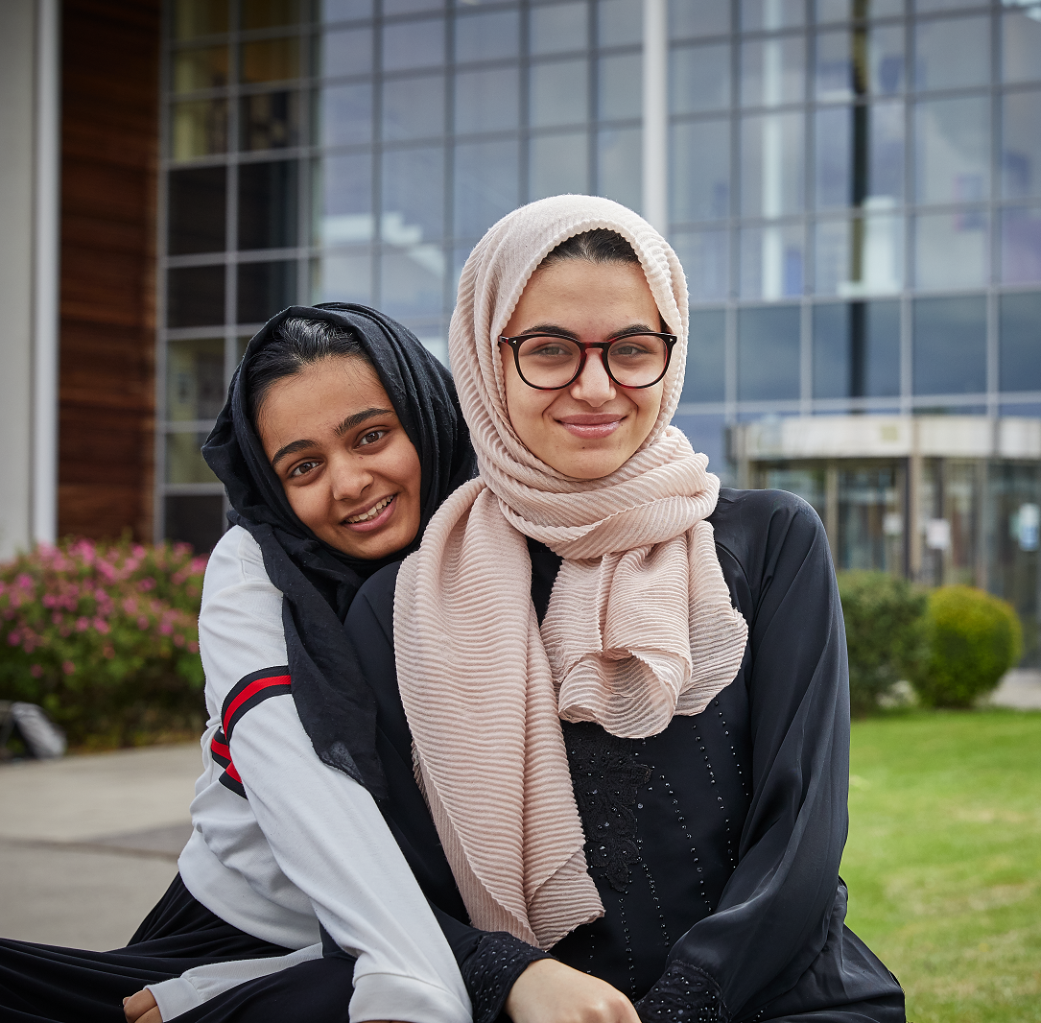

Community Curiosity Challenge Consideration Commitment
WHERE TO FIND APPRENTICESHIPS
For information about Apprenticeships & vacancies -
Not going to Uni
National Apprenticeship site
Milkround for school leavers
All about school leavers
Pathway CTM
Get my first job
The Apprenticeship Guide
UCAS
Find Apprenticeships | RateMyApprenticeship
Amazing Apprenticeships
Find the most up to date Higher and Degree Apprenticeship listing here

Slide 10
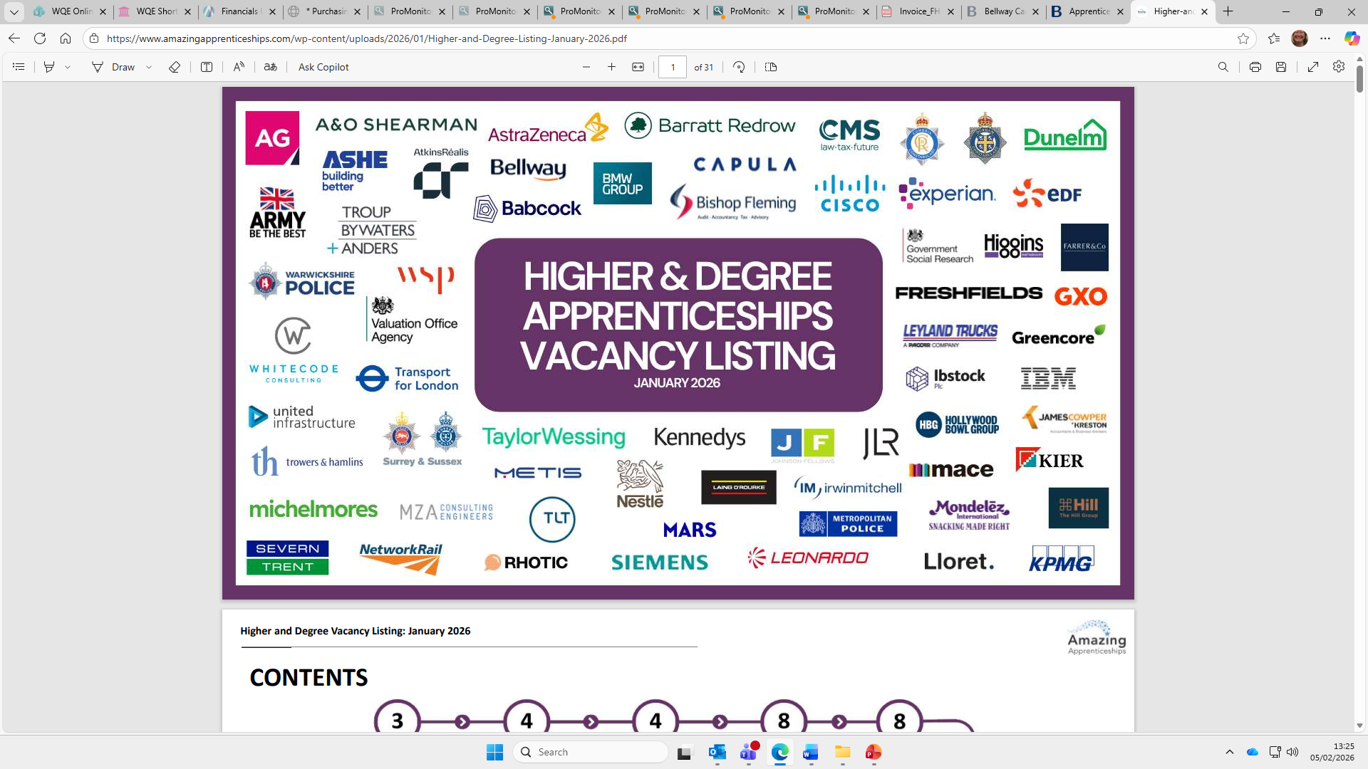
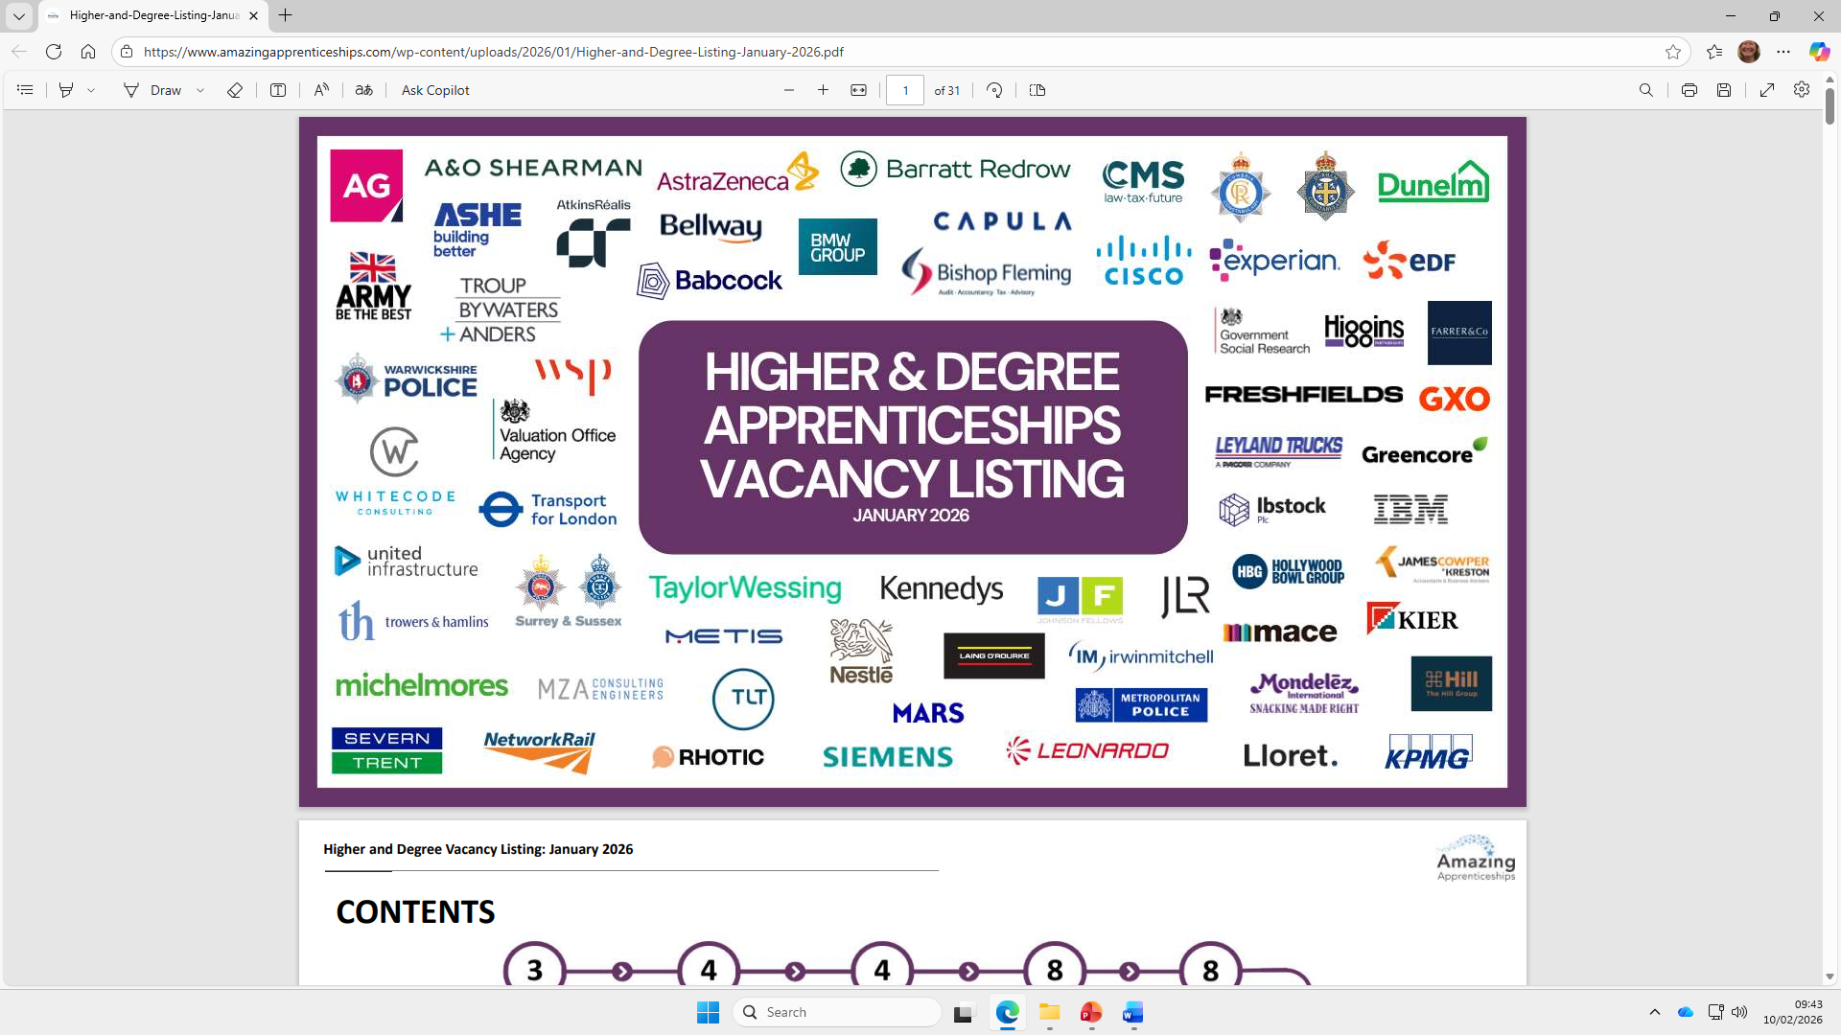

Slide 11
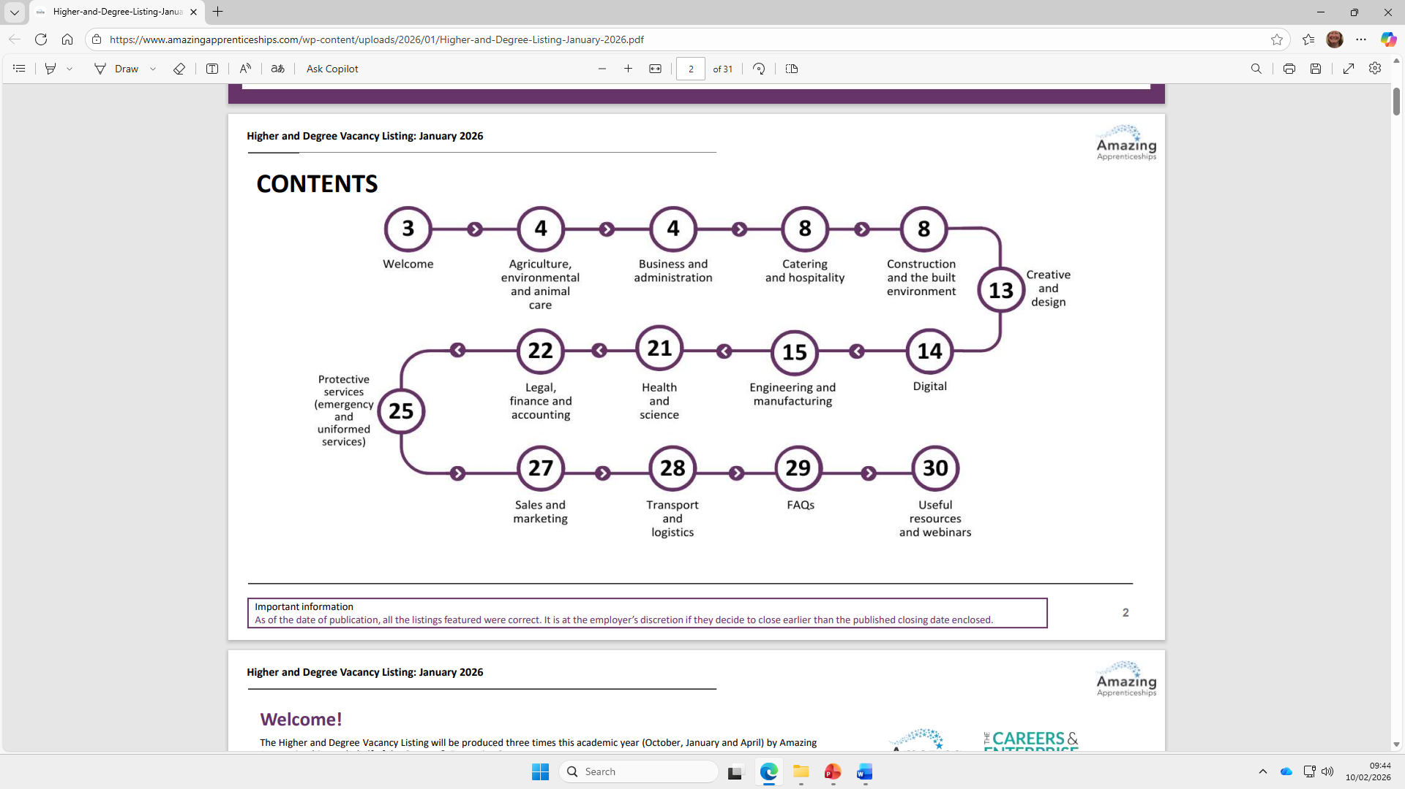

Slide 12
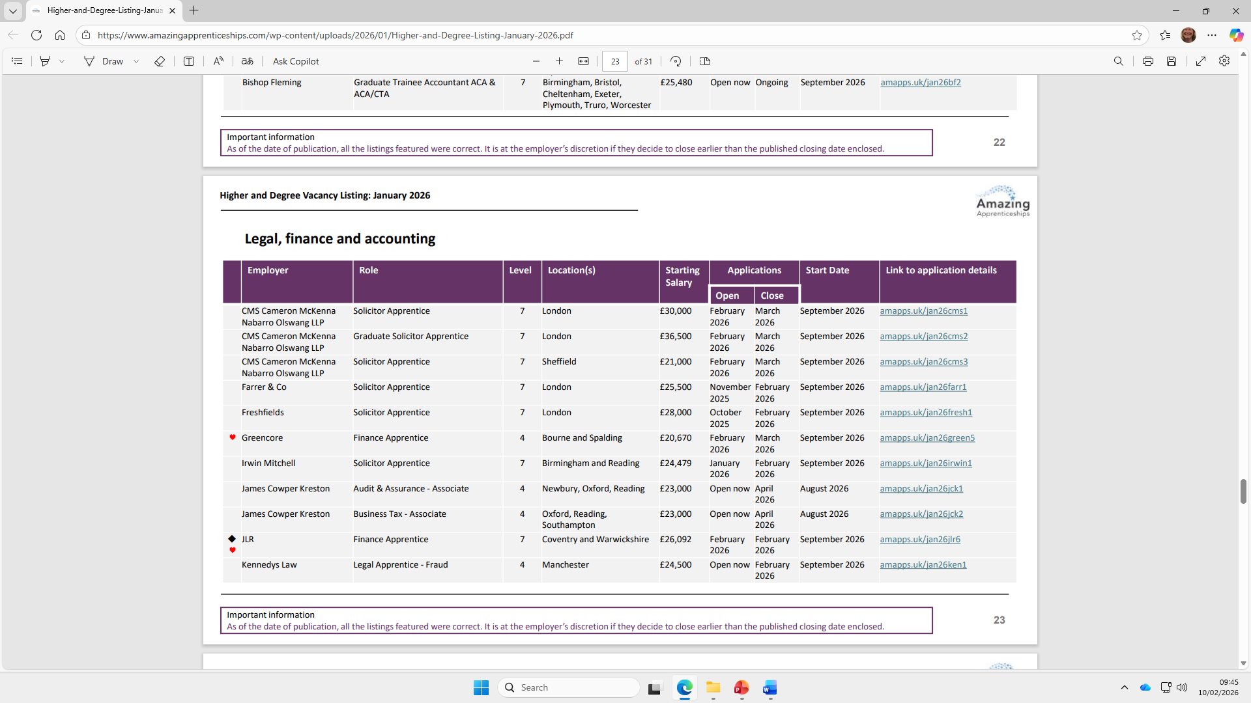

Slide 13
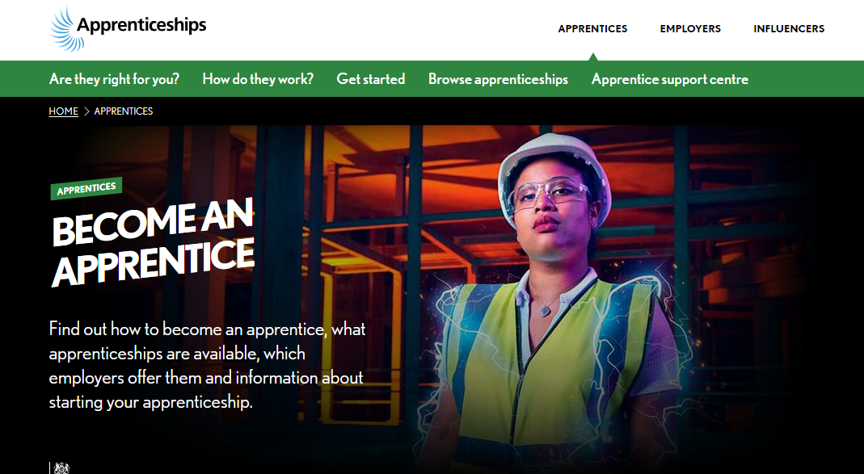
Community Curiosity Challenge Consideration Commitment
THE APPLICATION PROCESS
Apply directly to the employer (not through UCAS)
Usually CV/application form → online aptitude tests → video interview → assessment centre (online or in person) → interview →offered position
Timelines for recruitment
Competitive and tough
Notes:
Can apply for multiple opportunities
Can take months and is hard work
It’s tough – can be rejected at any stage. Also can close at any time
This is the process for higher and degree opportunities – for Level 3 simpler

Slide 14
HOW TO STRENGTHEN AN APPLICATION
Community Curiosity Challenge Consideration Commitment
Anything done ideally outside lessons to develop skills and experience –for example
Sport or Volunteering
Part-time work or work experience
Plus..
Make use of the WQE Careers team – for updates, events and activities and advice and guidance
Attend the WQE Careers Fair – Thursday 23 April, 6 – 8 pm at University Road

Slide 15

HOW TO STAND OUT IN THE APPLICATION PROCESS
Community Curiosity Challenge Consideration Commitment
Ensure your CV is updated and tailored for each opportunity
Focus on the skills developed
Research, research, research
Network
Practice interview skills - practice interviews at WQE 11 March 2026, 10.30 – 1.40pm
Make use of the Careers team and support at College
Notes:
It’s really all about the employability skills – this is what employers are going to be looking for and measuring in any assessments. They do understand that students are only just leaving College and understand they may not have lots of experience but they will be looking for students to have the potential to develop these skills.

Slide 16
Community Curiosity Challenge Consideration Commitment
SUPPORT AVAILABLE FOR STUDENTS
Careers service
PPM Support
Presentationstalks and workshops
Careers Service
Regular Careers updates
Support from other staff
WQE Careers Fair 2026
HE Exhibition
2026
FutureWise
June 2026
Application and interview support
Work with Coach (Jo Martin)
Mock assesmentcentre
Drop in sessions
Resources on WQE Online
WQE Careers Service
careers@wqe.ac.uk

Slide 17
A PLAN FOR THE YEAR – LEVEL 3 YEAR 1
Community Curiosity Challenge Consideration Commitment
Between now and the end of Summer
Focus on developing skills and experiences
Research opportunities available – come up with a shortlist of companies, identify when they recruit, sign up to talent communities if available
Attend WQE Careers events and make use of the service
Sign up for Next Gen Degree Apprenticeship coaching
Prepare a stand out CV
Plan a back up
Autumn term onwards
It’s all about the applications
Use the support from WQE
Notes:
It’s really all about the employability skills – this is what employers are going to be looking for and measuring in any assessments. They do understand that students are only just leaving College and understand they may not have lots of experience but they will be looking for students to have the potential to develop these skills.

Slide 18
A PLAN FOR THE YEAR – LEVEL 3 YEAR 2
Community Curiosity Challenge Consideration Commitment
It’s all about applying
Research the opportunities available and get those applications in
Have a mock interview on Wednesday 11 March, between 10.30 and 1.40 pm
Attend the WQE Careers Fair on Thursday 23 April from 6 – 8pm at University Road
Firm up a back up plan
Use the Careers service for support
Notes:
It’s really all about the employability skills – this is what employers are going to be looking for and measuring in any assessments. They do understand that students are only just leaving College and understand they may not have lots of experience but they will be looking for students to have the potential to develop these skills.

Slide 19
Community Curiosity Challenge Consideration Commitment
MORE USEFUL WEBSITES
For work experience opportunities
UCAS virtual work experiences
Pathway CTM
The Sixth Formers guide
Springpod
Young Professionals
Futures for all
PwC virtual insight week
Deloitte Career Shapers and ASPIRE
Grant Thornton Ignite
For more information on Apprenticeships
Sign up for the UCAS parent newsletter here
Get my first job newsletter
The Parents Guide

Slide 20
HOW TO CONTACT CAREERS
Community Curiosity Challenge Consideration Commitment
Community Curiosity Challenge Consideration Commitment
Students can
Visit/drop in
University Road, Mon-Fri in Careers (next to the Study Centre). Regent Road – Mon, Wed and Thurs in Hub 2. Regular drop in between 1 and 2pm
Email - careers@wqe.ac.uk
MS Bookings students can book their own appointment here

Slide 21
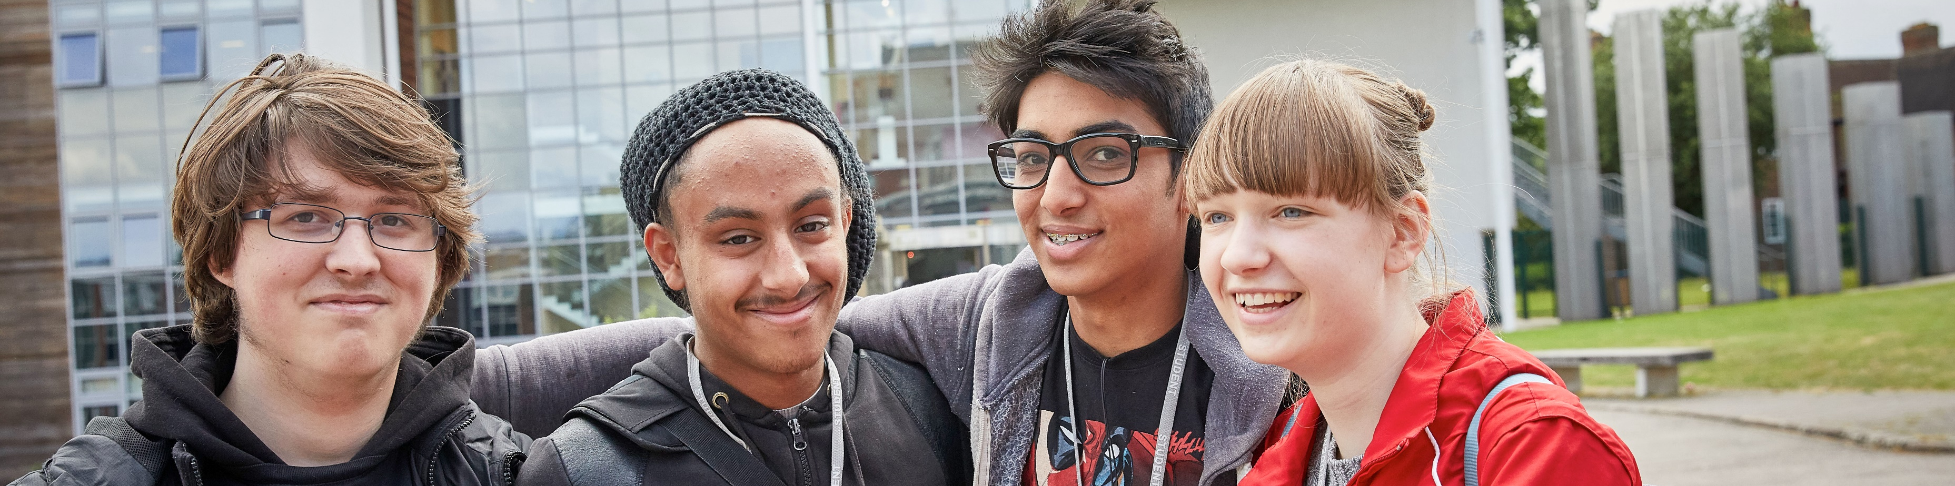
Community Curiosity Challenge Consideration Commitment
Contact details
Kate O’Farrell
Careers Education Manager
0116 2471147
careers@wqe.ac.uk

