Slide 1
Applying to the 16-19 Bursary Fund 2023-2024
If you are worried about the additional costs involved in coming to college you can apply for financial support from the means-tested 16-19 Bursary Fund.
The following guidance information will help you to complete your Bursary Application Form and explains the evidence you’ll need to support your application.
Please read through this guidance before completing your application:
an incomplete form and/or incorrect or missing evidence is likely to delay any support you might be eligible for.

Slide 2
How does the process work?
After reading this guidance, if you decide to apply, you will need to complete an application form and email it with your supporting evidence to our Bursary Assessments Team.
The outcome of your application will be sent via email to your WQE email account.
If your application is successful, we will provide details of the support available as part of your bursary award.
If your application is unsuccessful you will be given a reason why.
Students can, in either case, share the outcome with their parent/carer.
Once we’ve told a student they’re eligible, it is your responsibility to ask for the support available to you during the academic year. We deal with the student on a day-to day basis for this. We’re not scary - please ask us!

Slide 3
What does the bursary cover and what could I be eligible for?
The aim of the 16-19 Bursary fund is to support eligible students with costs you will incur by remaining in education. The amount you will receive will vary depending on your individual circumstances but support can cover:
Help with travel to college
Meal support
Specific course related costs (stationery, calculator, revision guides/additional text books, art materials, sports kit)
Contribution towards college trips
UCAS application fee (Year 2 students only)
Students eligible for the Enhanced Bursary may also be eligible for a regular weekly payment.
Students (without an EHCP) age 19+ at the start of their course may be eligible to apply for discretionary support. Limited funding is available, students should see the Student Services Team to discuss their individual circumstances.

Slide 4
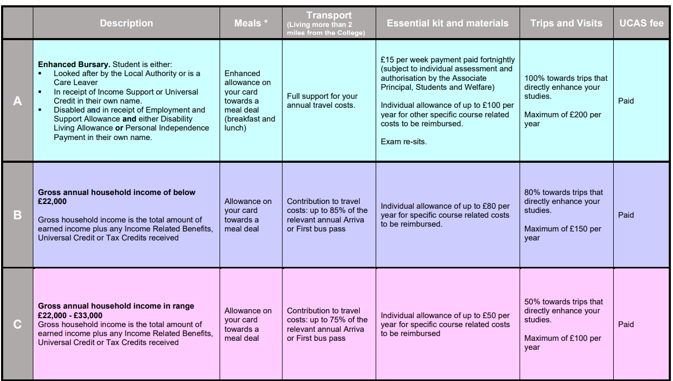
Eligibility and Support 2023/24
* Meal support for students studying off-site at Studio 79, LCPA or BACA will be paid via weekly BACS transfer

Slide 5
What evidence do I need?
For all applications we need to see evidence of the student’s bank details.
The ESFA funding guidance states that we should not pay bursary support to anyone other than the student.
The account must be in your name alone. If a you have an account with your parent/carer named as a trustee, we are unable to accept this for the purpose of the bursary. You will need to open an account in your own name alone.
Your bank account evidence needs to be a copy of a statement from your bank or building society. It must clearly display your full name, sort code and account number.
Other evidence required will depend on the criteria that makes you eligible for bursary support.

Slide 6
Are you a student who is in care, a care leaver or living independently?
The Enhanced Bursary provides further support for the most vulnerable students. The table below shows the students who are eligible for this support and the evidence required:
Eligibility Criteria | Evidence Required
Students currently in care or who have left care | Written confirmation of your current or previous looked-after status from the local authority who looks after you or is providing your leaving care services
Students in receipt of Income Support or Universal Credit in their own right | A copy of your Universal Credit or Income Support award notice and evidence that you are living independently and financially supporting yourself and anyone who is dependent on you and living with you
Students in receipt of Employment and Support Allowance and Disability Living Allowance or Personal Independence Payment in their own right | A copy of your Universal Credit claim from Department for Work and Pensions. Evidence of receipt of Disability Living Allowance or Personal Independence Payment must also be provided

Slide 7
Discretionary Bursary: Household Income
If your household income is less that £33,000 you may be eligible for support from the Discretionary Bursary fund. Please note that this includes income from Benefits and earnings.
The evidence required will depend on which of the below your parent/carer is in receipt of:
Income Based Job Seekers Allowance
Income Based Employment and Support Allowance
The guaranteed element of State Pension Credit
Income Support
Universal Credit with a household income of below £33,000
Support from the National Asylum Support Service
Tax Credits with a household income of below £33,000

Slide 8
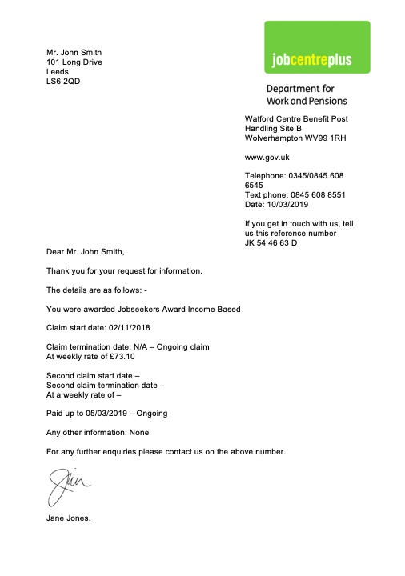
Income Based Job Seekers Allowance
Evidence must be either a photo (this should be either a .jpg or .bmp) or a scanned/original document (Word or Adobe pdf).
Please note there are two different types of Job Seekers Allowance and only the Income Based version of Job Seekers Allowance qualifies for support. For parents/carers in receipt of Income Based Job Seekers Allowance we will need to see a letter, that is no more than one month old, from the benefits agency confirming receipt of the benefit. If you do not currently have a letter you will need to ask your benefit agency to provide one for you.

Slide 9
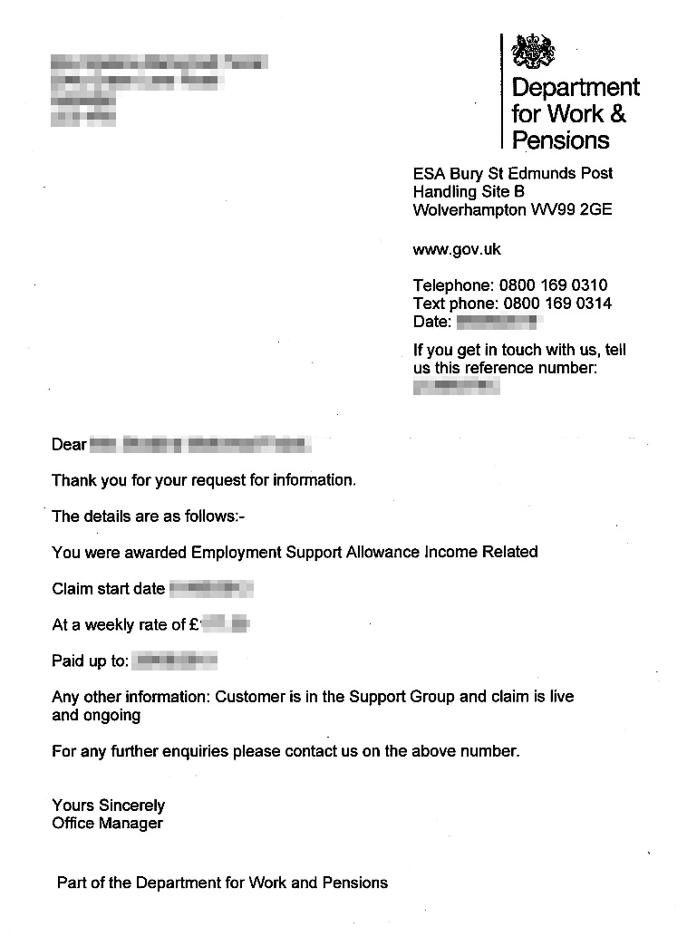
Income Based Employment and Support Allowance
Evidence must be either a photo (this should be either a .jpg or .bmp) or a scanned/original document (Word or Adobe pdf).
Please note there are two different types of Employment and Support Allowance and only the Income Based version of Employment and Support Allowance qualifies for support. For parents/carers in receipt of Income Based Employment and Support Allowance we will need to see a letter, that is no more than one month old, from the benefits agency confirming receipt of the benefit. If you do not currently have a letter you will need to ask your benefit agency to provide one for you.

Slide 10
The guaranteed element of State Pension Credit
Evidence must be either a photo (this should be either a .jpg or .bmp) or a scanned/original document (Word or Adobe pdf). For parents/carers in receipt of Pension Credit we will need to see a letter, that is no more than one month old, from the benefits agency confirming receipt of the benefit. If you do not currently have a letter you will need to ask your benefit agency to provide one for you.

Slide 11
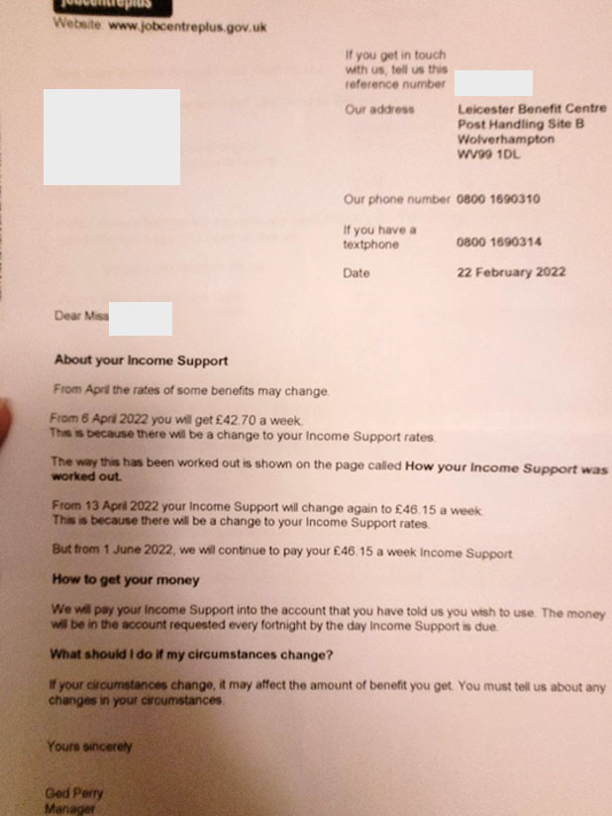
Income Support
Evidence must be either a photo (this should be either a .jpg or .bmp) or a scanned/original document (Word or Adobe pdf).
For parents/carers in receipt of Income Support we will need to see a letter, that is no more than one month old, from the benefits agency confirming receipt of the benefit. If you do not currently have a letter you will need to ask your benefit agency to provide one for you.

Slide 12
Universal Credit with gross household income below £33,000
Evidence must be either a photo (this should be either a .jpg or .bmp) or a scanned/original document (Word or Adobe pdf). For parents/carers in receipt of Universal Credit we will need to see the three most recent Universal Credit monthly statements; these can be accessed via the online portal. Please make sure you send the full document for each month. If Universal Credit has only recently been awarded please provide the statements that are available and the summary document. These can all be accessed from the online portal.

Slide 13
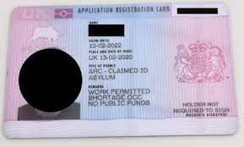
Support from the National Asylum Support Service
Evidence must be either a photo (this should be either a .jpg or .bmp) or a scanned/original document (Word or Adobe pdf).
We will need to see a letter confirming your NASS registration number or a copy of your Application Registration Card (ARC). Please be aware that you will be eligible for specific forms of support; see Student Services for more details.

Slide 14
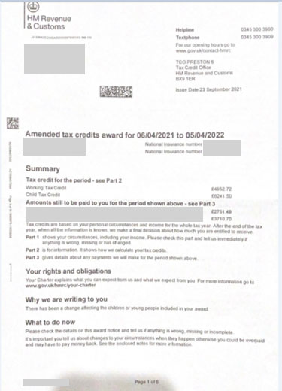
Tax Credits with gross household income below £33,000
Evidence must be either a photo (this should be either a .jpg or .bmp) or a scanned/original document (Word or Adobe pdf).
Please note: The income on a Tax Credit Award Notice is calculated by the total of your Tax Credits and earned income combined.
For parents/carers in receipt of Tax Credits we will need to see the Tax Credit Award Notice (TCAN) for the period 06/04/2023 to 05/04/2024.
Important:
ALL 6 pages of the document must be provided
The student for whom the application is made must be named in the TCAN throughout the entire period of the TCAN. If your parents/carers have not notified HMRC that you are continuing into Further Education, they must do so immediately. We cannot process your application without this information
The TCAN must show your legal name (not your preferred or shortened name)
If the TCAN refers to receipt of another income-related benefit we need to see evidence of the stated benefit instead of the TCAN. If the Benefit is no longer being paid, your parent/carer will need to request an up to date TCAN.

Slide 15
Making your application
Please help us to help you by having the evidence indicated available when you are ready to complete an application. We deal with applications in strict order of receipt so incomplete or incorrect evidence will delay processing.
Please do not submit alternative documents as evidence, for example we are unable to accept bank statements as evidence of receipt of benefits.
When you submit your application, please do not submit another application form if you don’t hear from us straight away. We do our best to process applications as quickly as possible but this may take a little longer at the beginning of the academic year due to the large volume we receive. We thank you for your patience during this time.
PLEASE NOTE: If you are not in receipt of any of the benefits we have outlined here, you would not be eligible for support from the 16-19 Bursary Fund. However, students can apply at any point during the academic year should there be a change of circumstances

Slide 16
Making your application
When you are ready to submit your application you can access the Application Form here:
16-19 Bursary Application 2023-24
Please send your completed application with the supporting evidence to:
bursary.evidence@wqe.ac.uk
If you have any questions or need any support with completing your application please email student.services@wqe.ac.uk or visit the Student Services Team at either campus

